Slide 1





DATA VISUALIZATION FINAL PROJECT
TOPIC: TRACKING CUSTOMER SATISFACTION AND BUSINESS ENGAGEMENT
Submitted By
Sai Lokesh Siddanathi

Slide 2
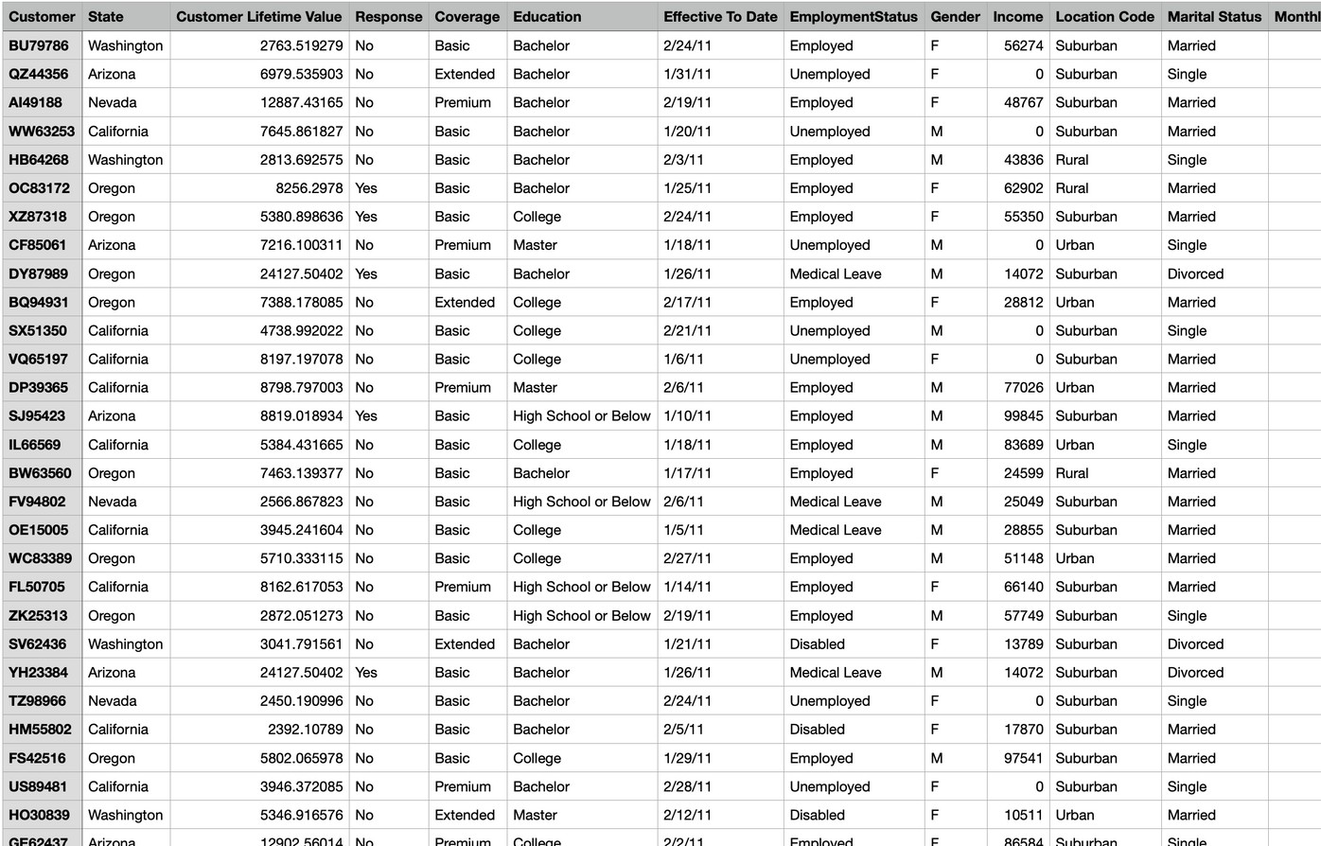
Data Set
Customer Name Location
ID
Details Education Employment Gender Income Loans Taken Coverage

Slide 3


PROJECT PLAN
Data Pre-processing
EDA – Exploratory Data Analysis
Visualisation

Slide 4

DATA PRE-PROCESSING
Data Cleaning
Identifying Missing Values
Removing Duplicates

Slide 5


Slide 6
Analysis with R
Conversion Rate in Sales Channel

Slide 7
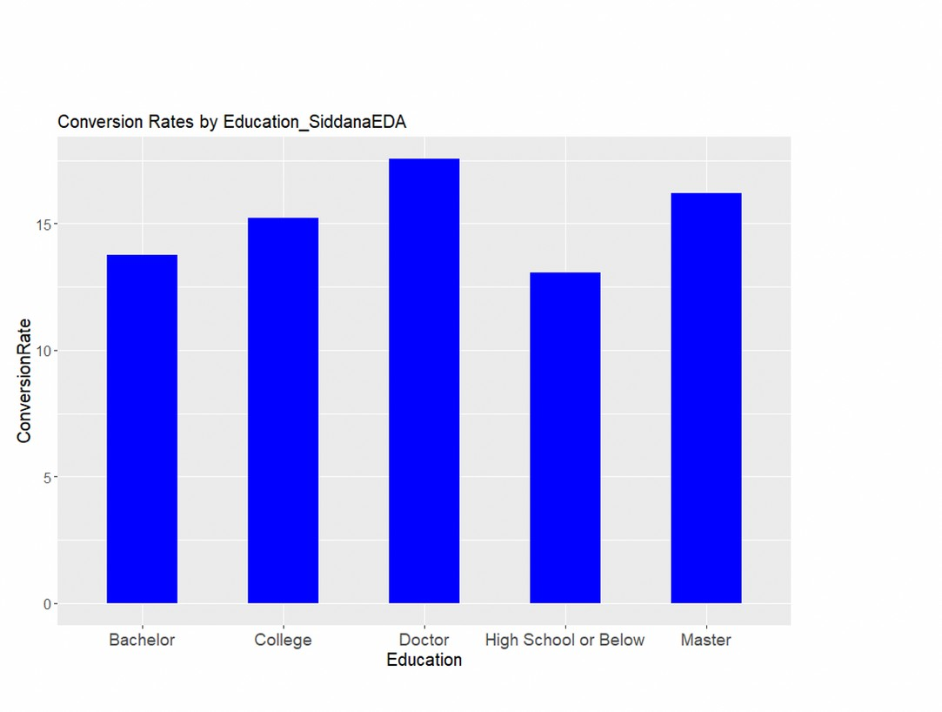
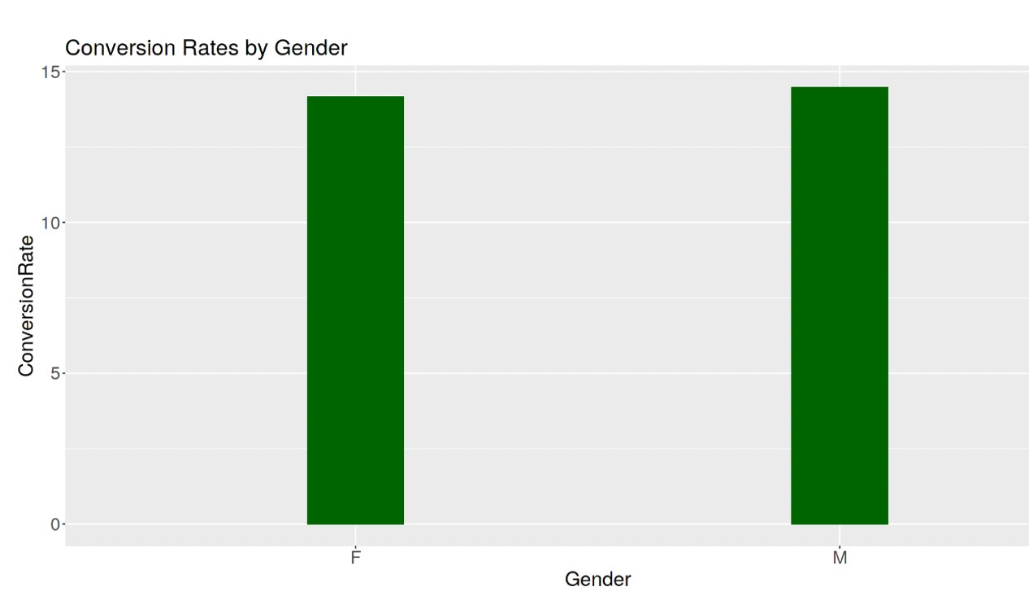

Slide 8
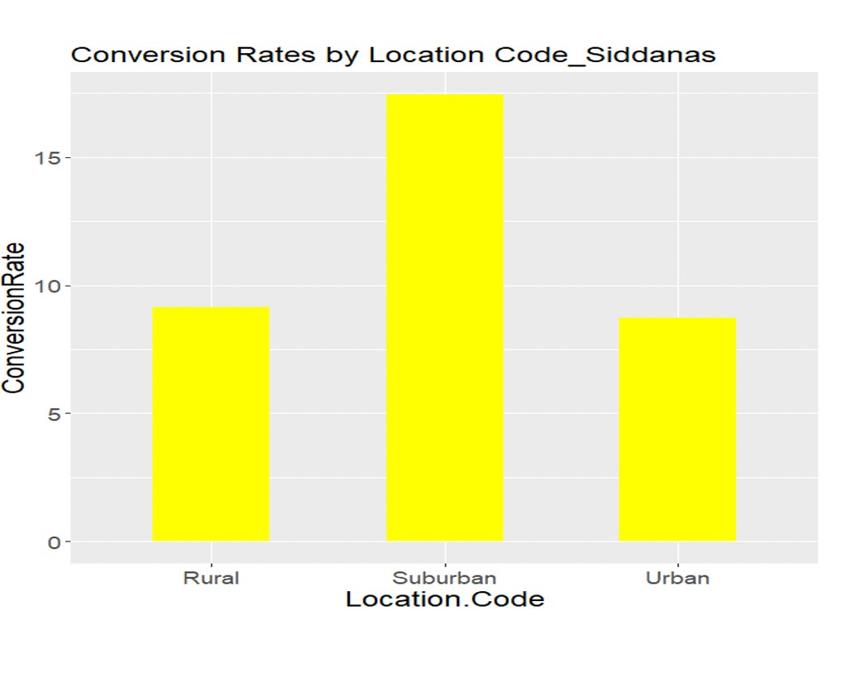
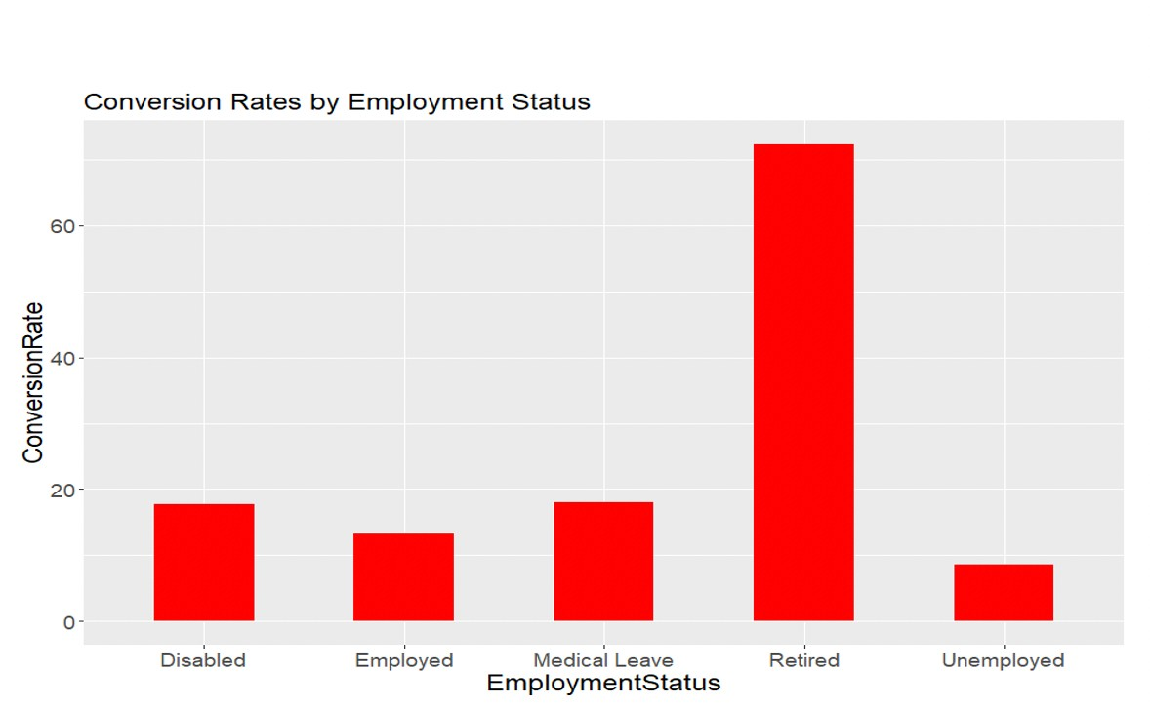

Slide 9


Slide 10
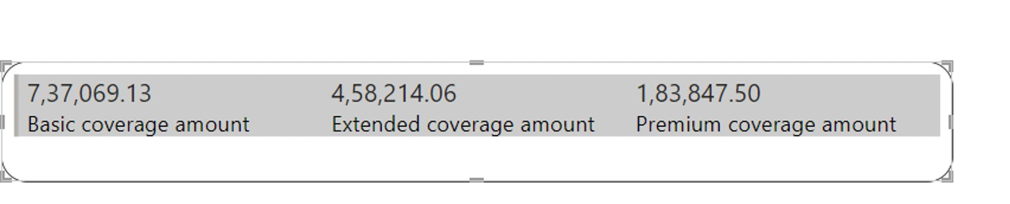
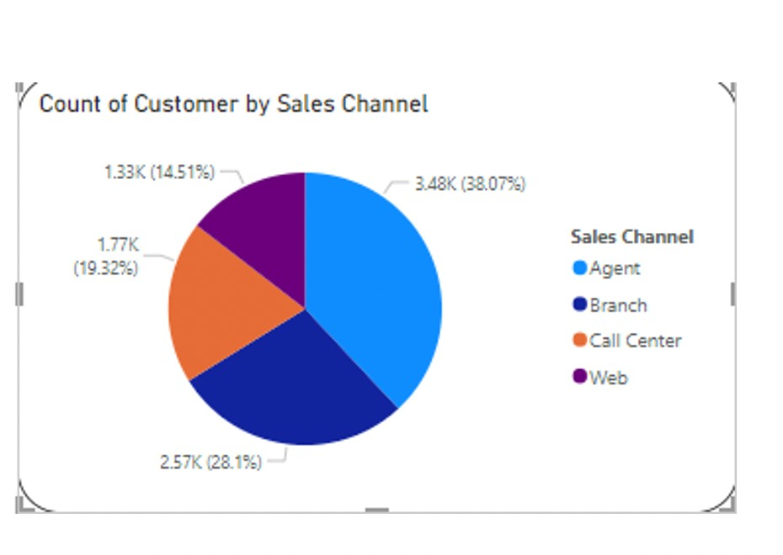
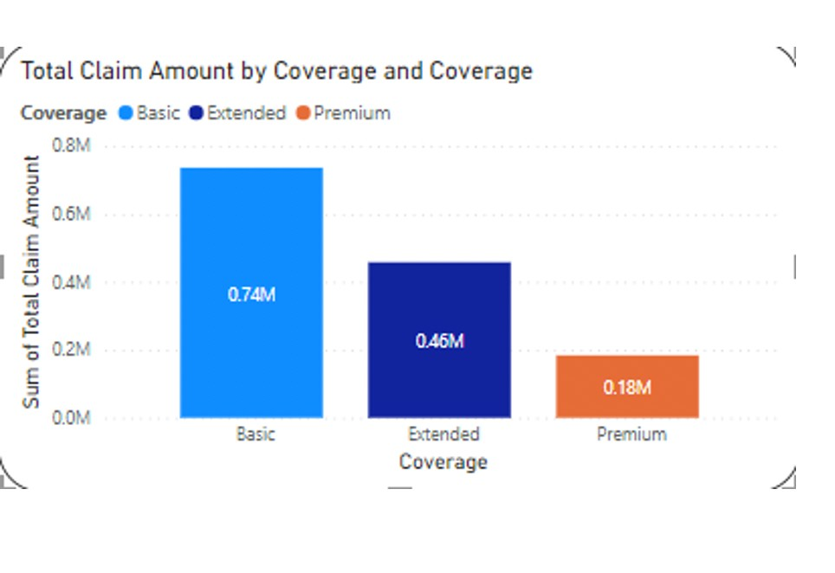

Slide 11
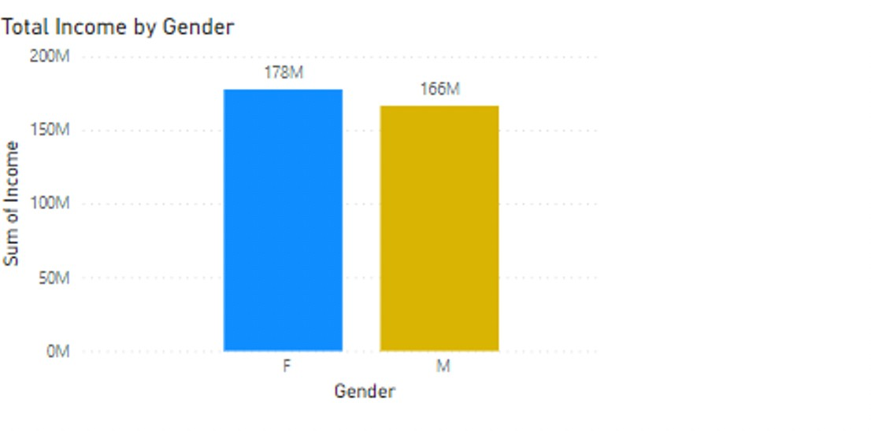
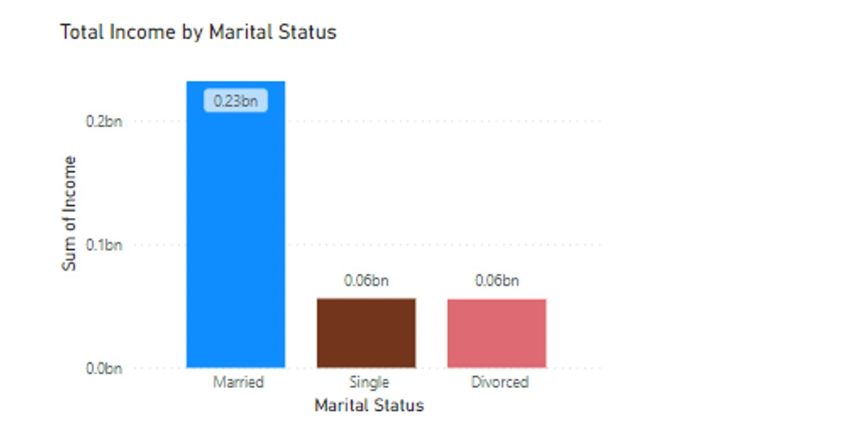
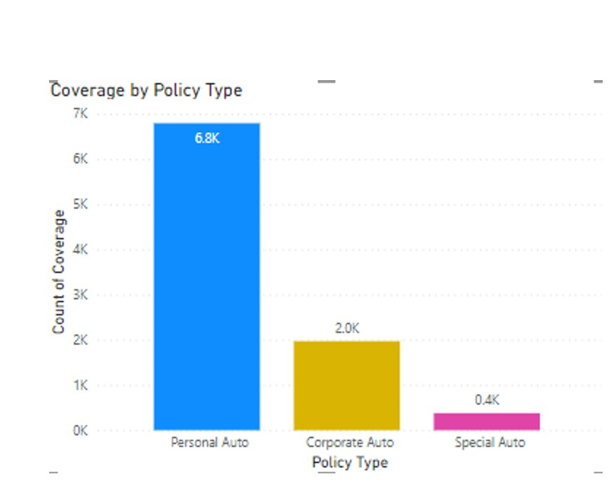
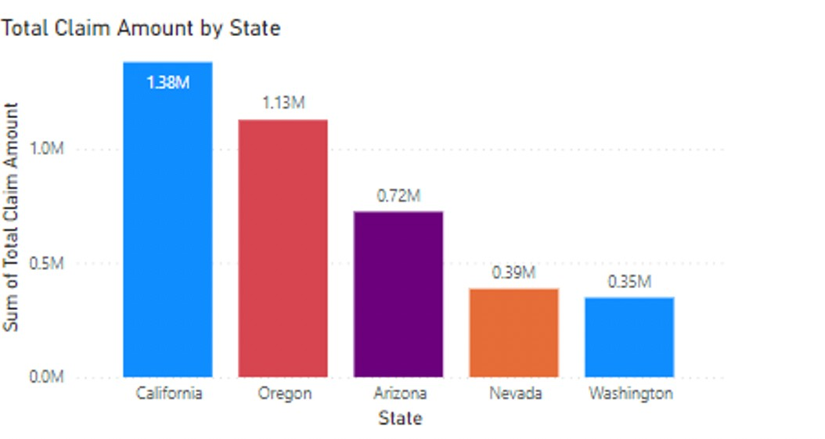

Slide 12
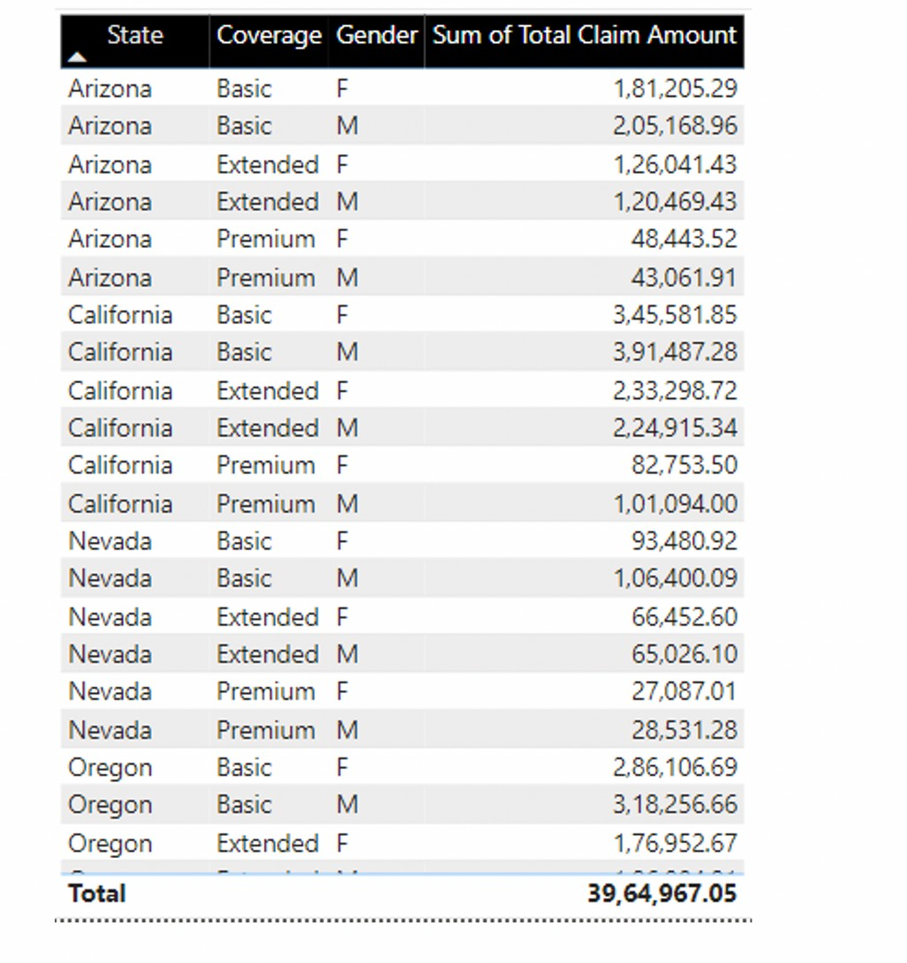

Slide 13


Slide 14
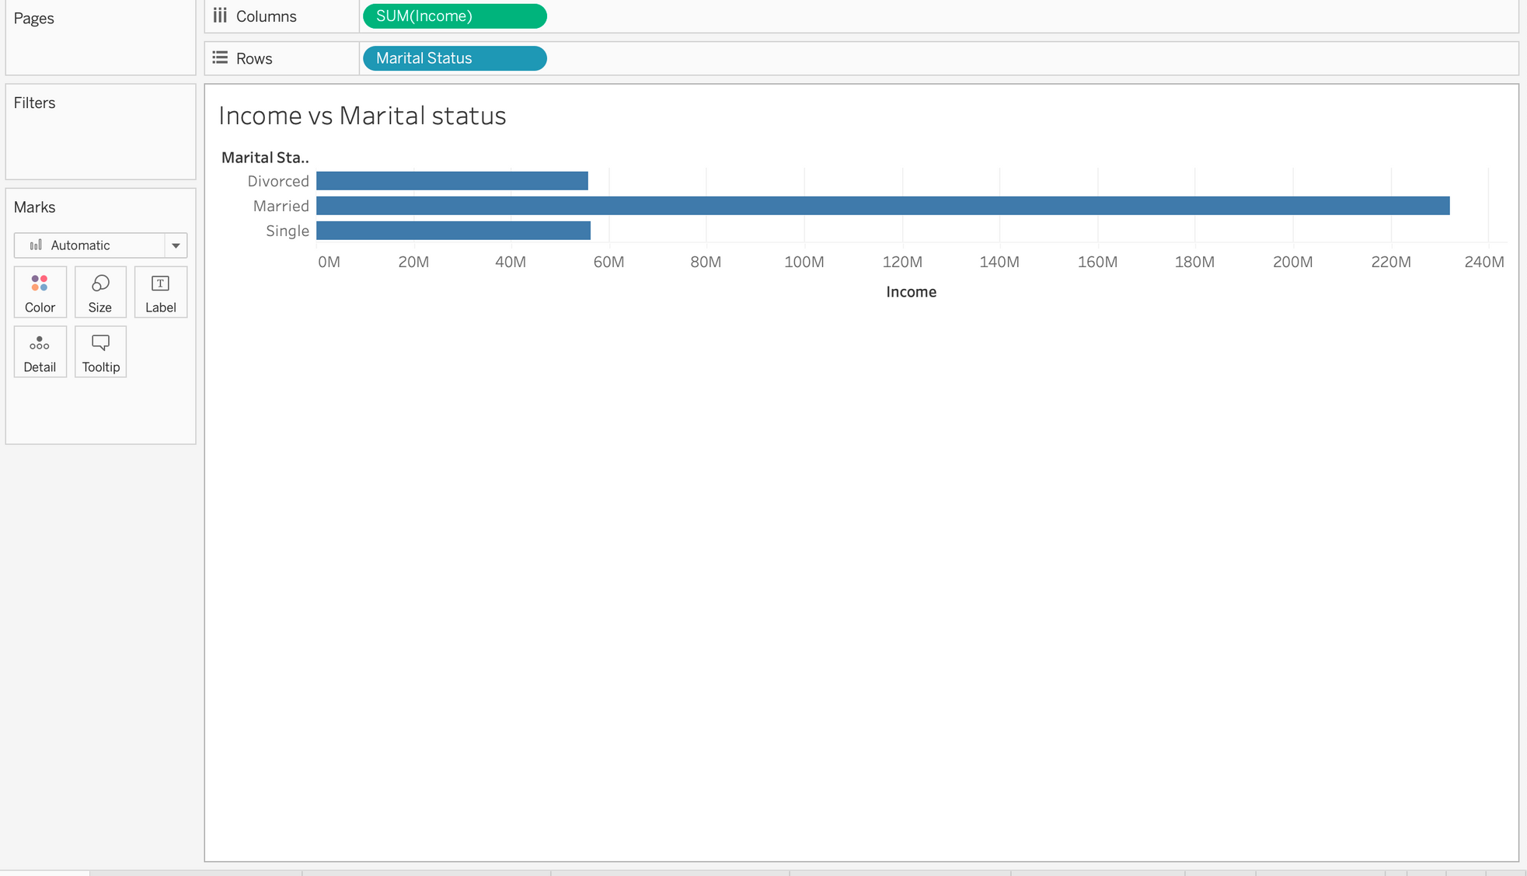
Bar Graph Income vs Marital status

Slide 15
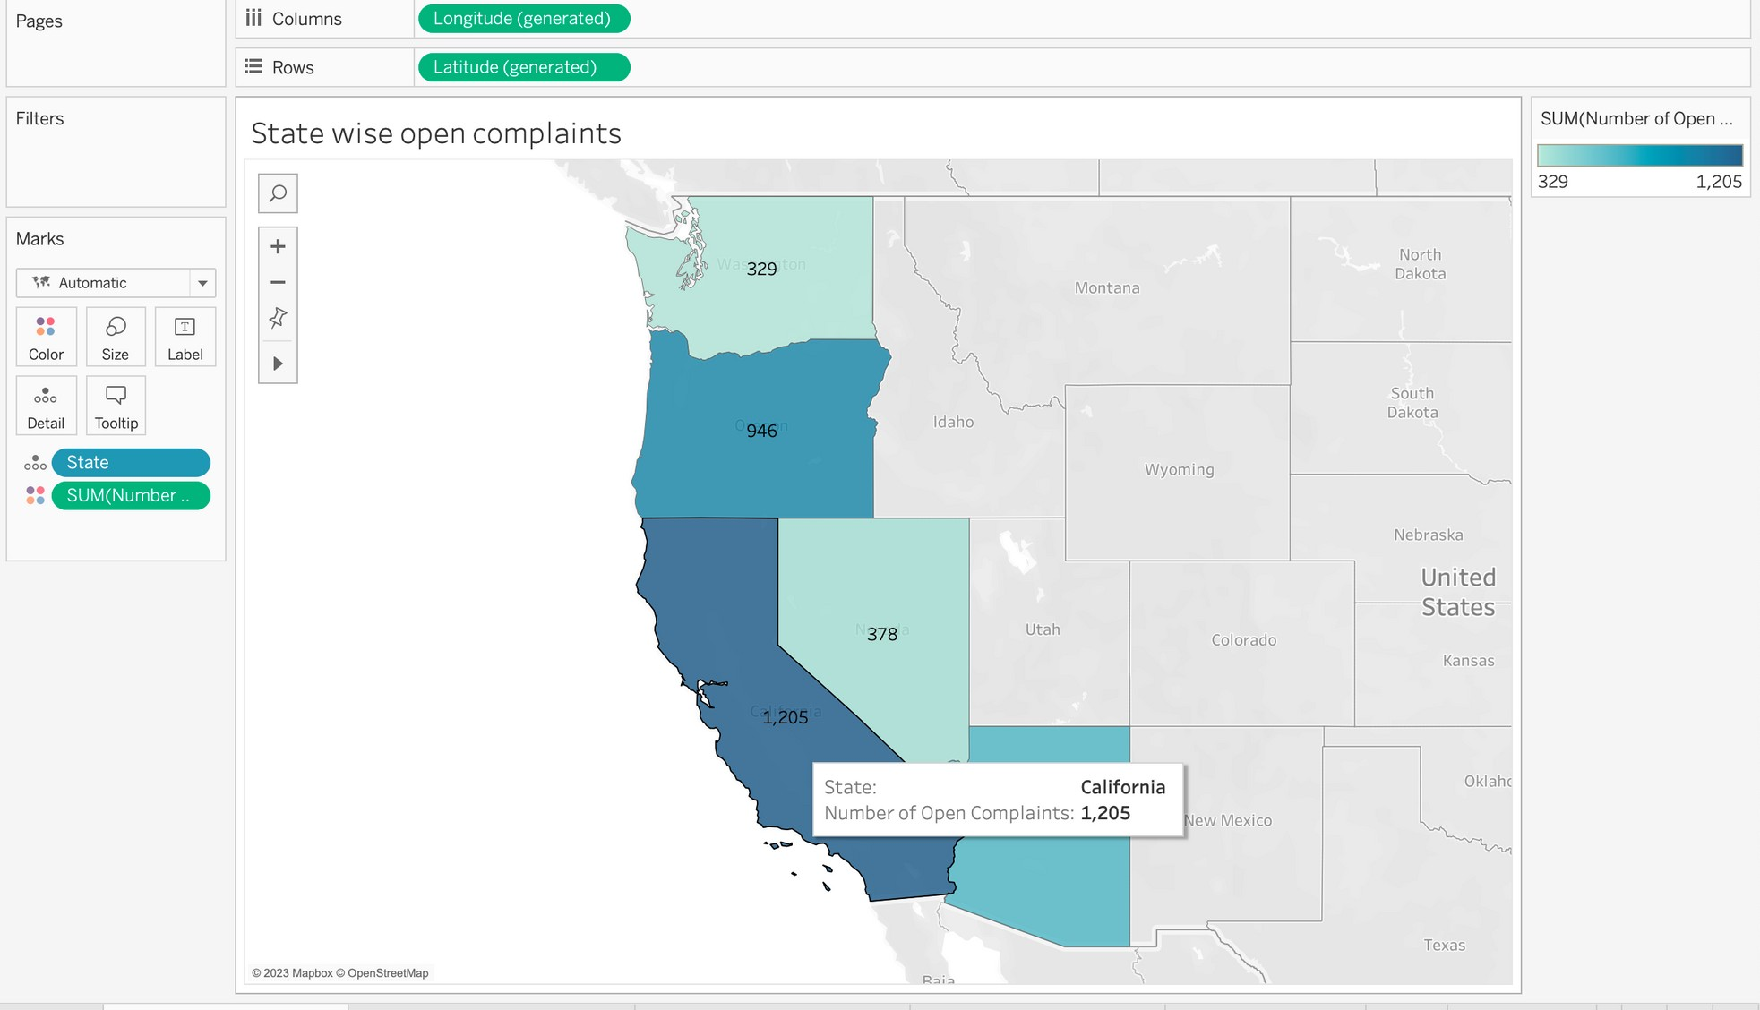
Filled Map state wise open compliants

Slide 16
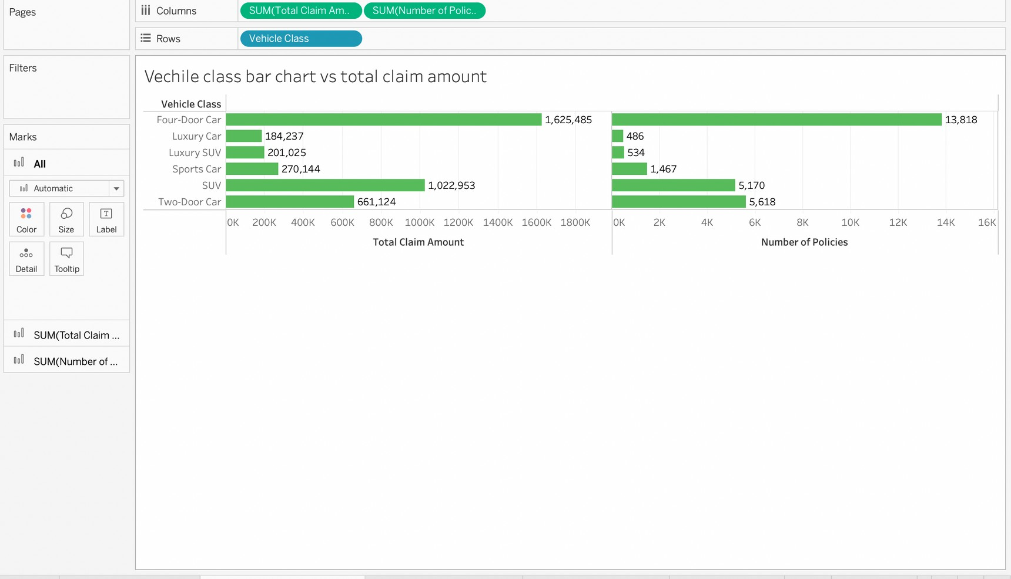
Bar Chart Vechile class vs Total Claim amount

Slide 17
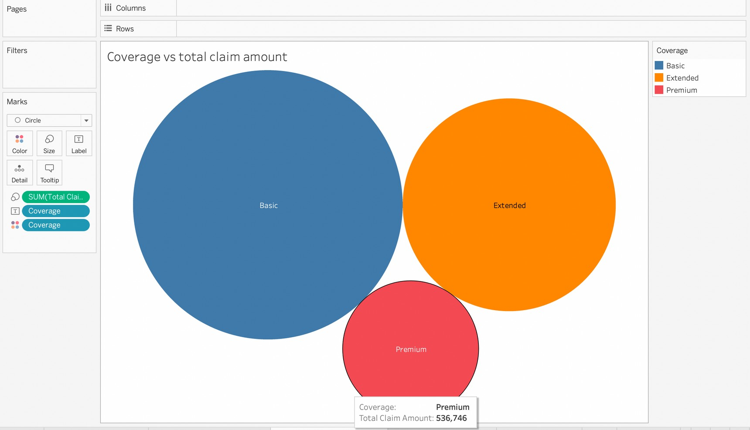
Bubble chart Coverage vs Total Claim Amount

Slide 18
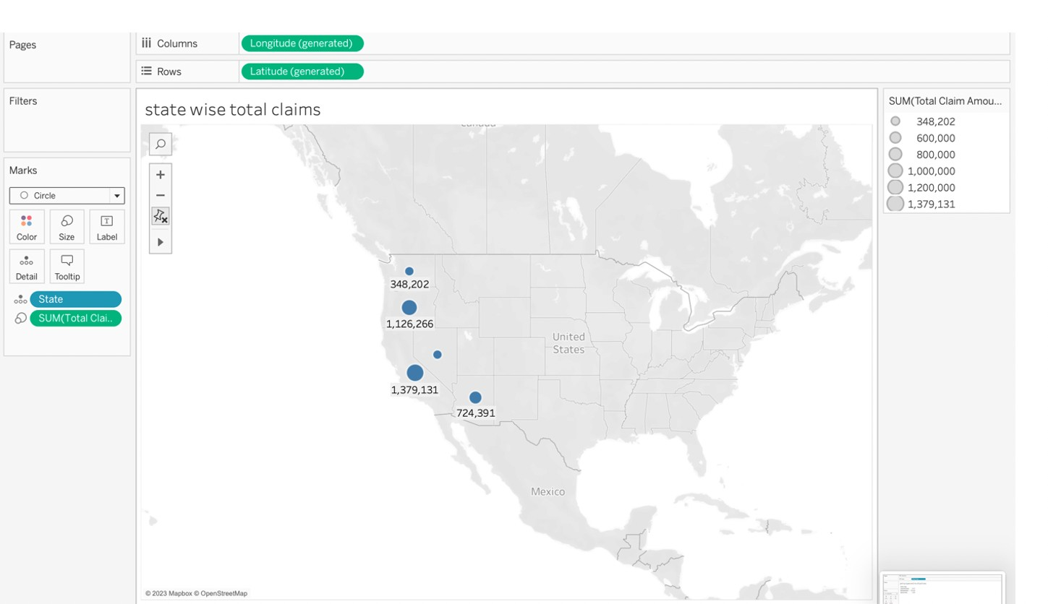
Geographic Map

Slide 19

Conclusion
From the Regression Analysis, we can use it for finding the significance of Variables and only Income, Number. Of. Policies, and Total Claim Amount had significant correlations with the variable Engaged, according to the results of this regression study.
Income and Total Claim Amount are positively related to Engaged (coefficients are positive). That means that the higher our clients' income and total claim amount, the more likely they are to interact

